Slide 1
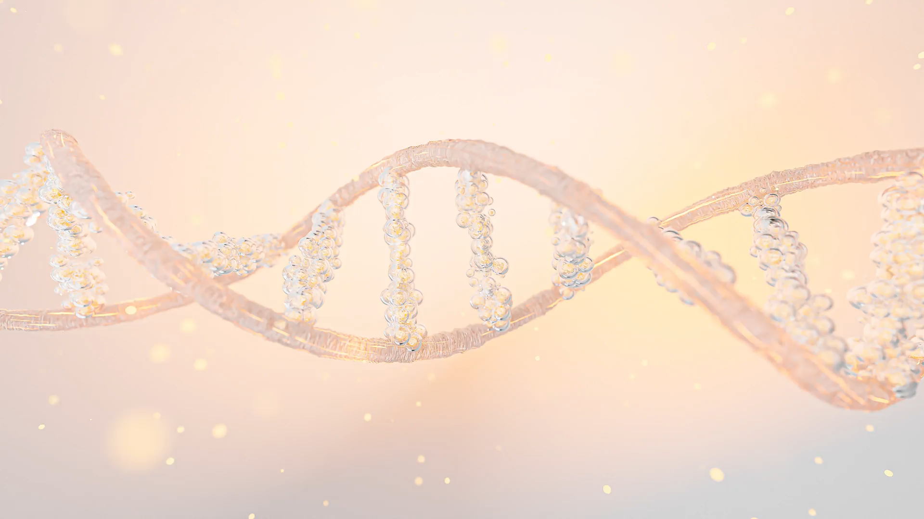

Bioinformatics
Paweł Dąbrowski-Tumański
MiNI Lecture, Fall 2025

Slide 2










https://pdabrowskitumanski.github.io
Formalities
Thursdays 8:15 (lecture), 10:00 (lab)
Grading – by lab assignement

Slide 3
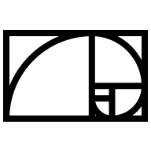


Prerequisites
Basic Python, Jupyter,
Pandas, ScikitLearn, PyTorch…
Basic math, statistics, linear algebra
Algorithms, Git, Linux…
Desires?

Slide 4



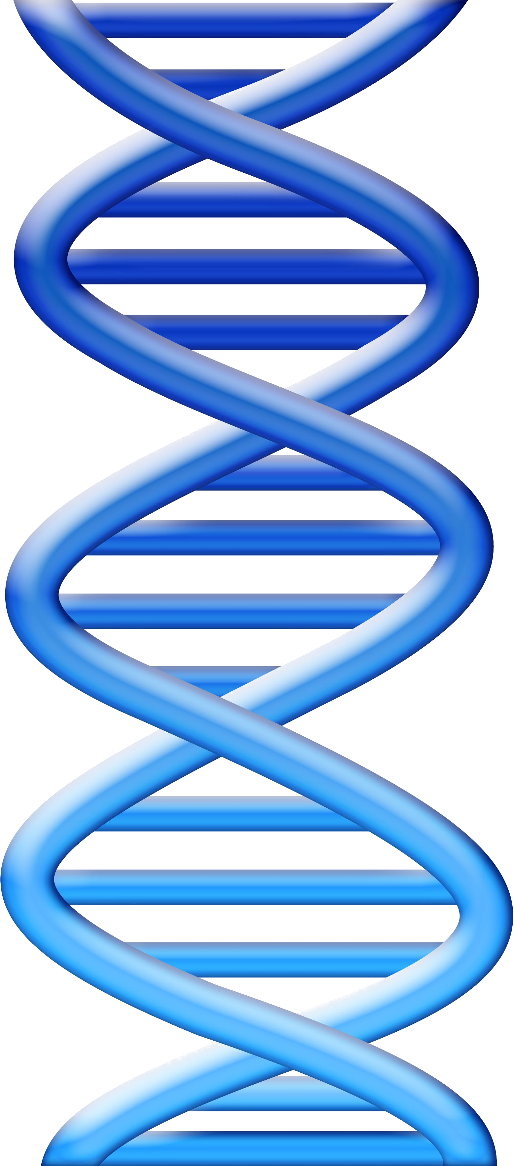
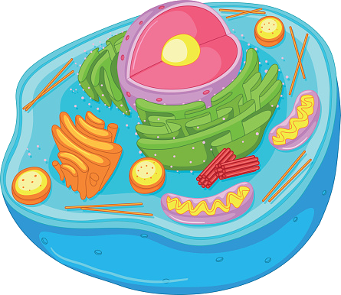
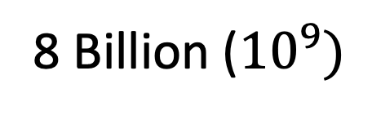
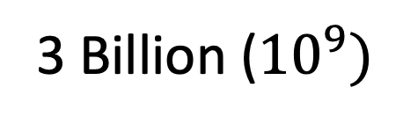
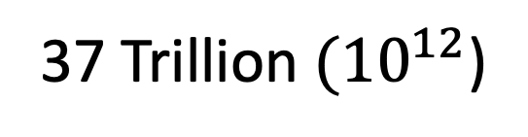
Bioinformatics
8 Billion (${10}^{9})$
37 Trillion $({10}^{12}$)
3 Billion (${10}^{9})$

Slide 5
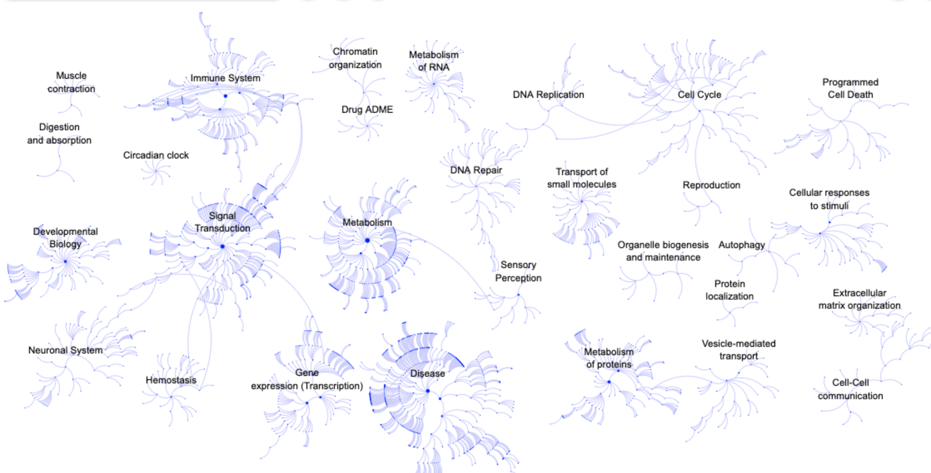
Bioinformatics

Slide 6
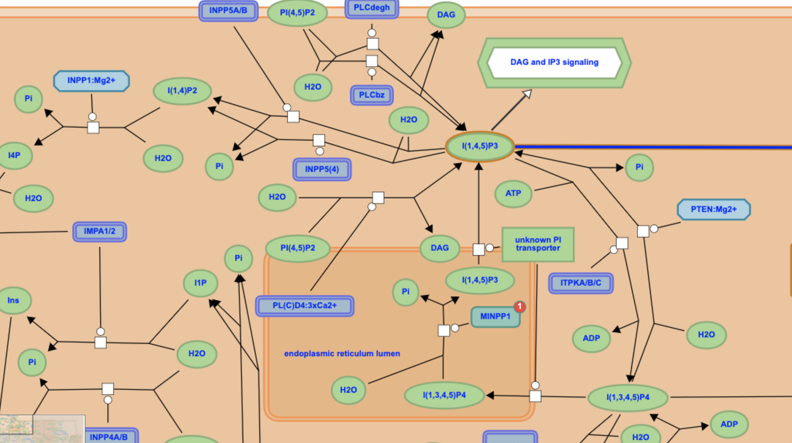
Bioinformatics

Slide 7

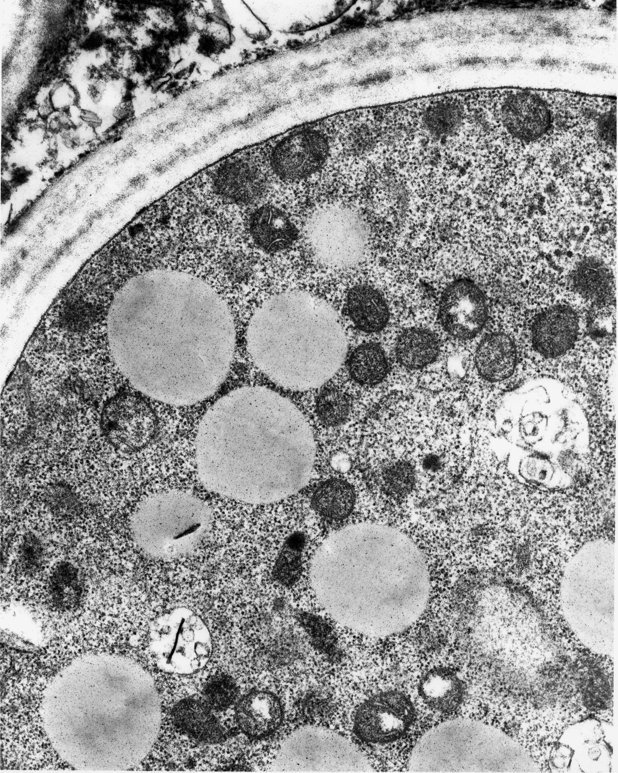
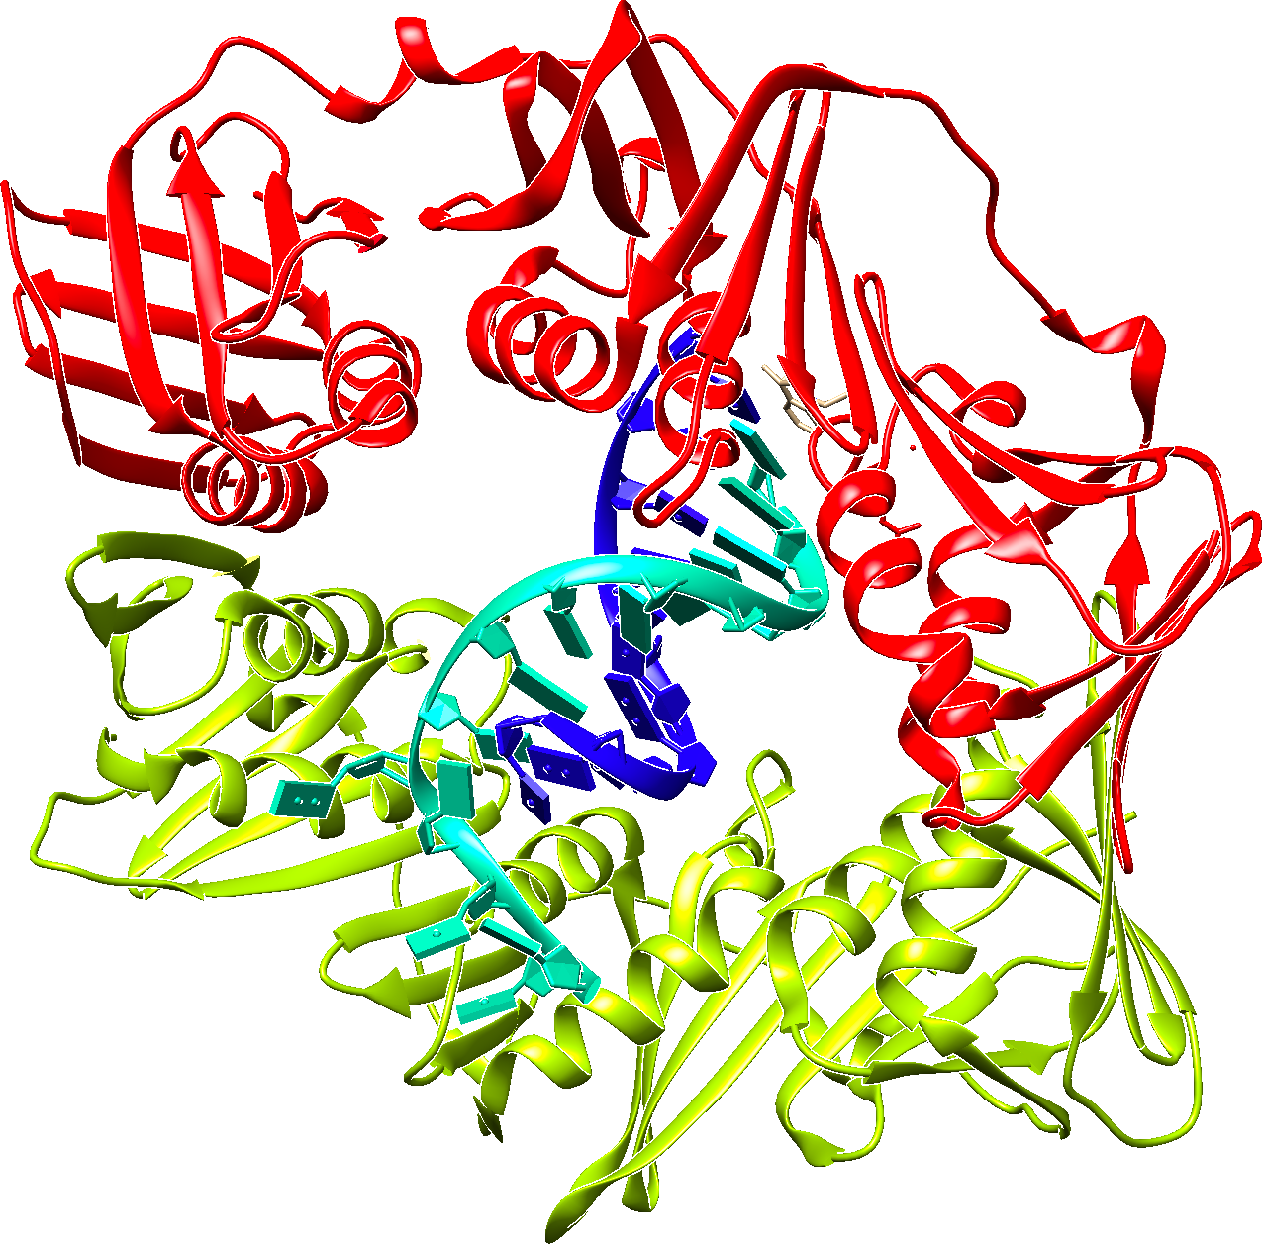
Bioinformatics
ACTGCTGCTG….
„Patient A had a repetetive headache after administration of drug ….”
AUCUGACAC….
PVKALFTRASC….
PARP1 -> 0.5
PARG -> 0.25
JAK1 -> 2.25
ADP -> 2.25

Slide 8

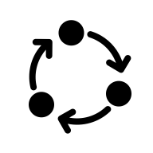

Bioinformatics
Deal with tons of data from experiments
Analyze data of different types
Model the complex, dynamic interactions
Avoid traps, false positive signals etc.

Slide 9
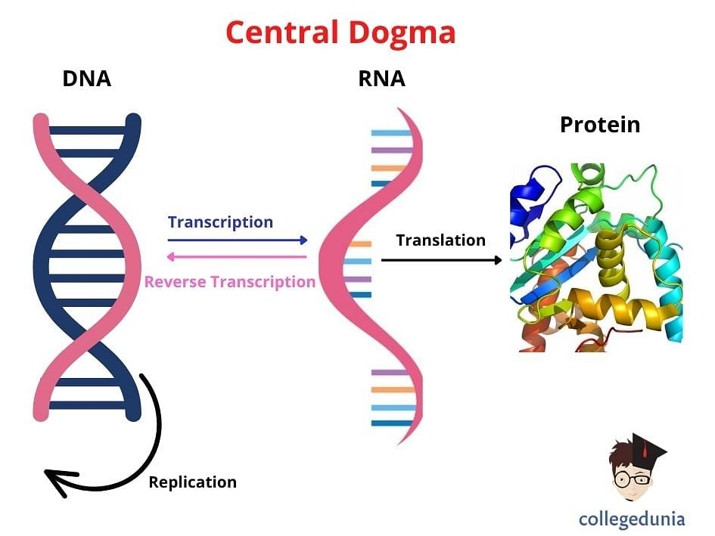
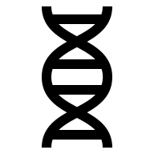
Central Dogma

Slide 10
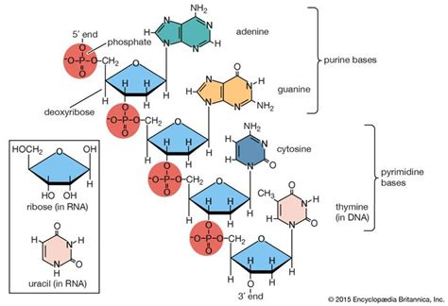
Central Dogma
DNA/RNA structure

Slide 11
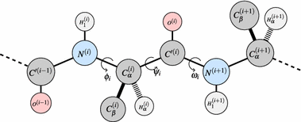
Central Dogma
Protein structure

Slide 12
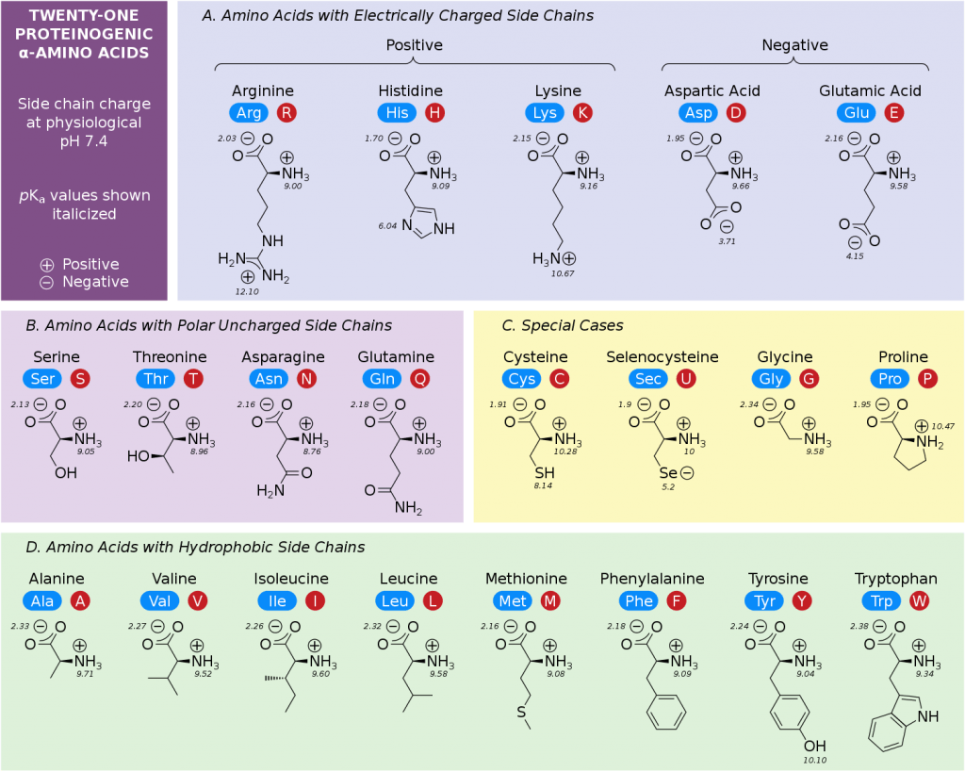
Central Dogma

Slide 13
Central Dogma
DNA: ACTGCTGTCACT…
RNA: ACUGCUGUCACT…
Protein: TAFT…

Slide 14
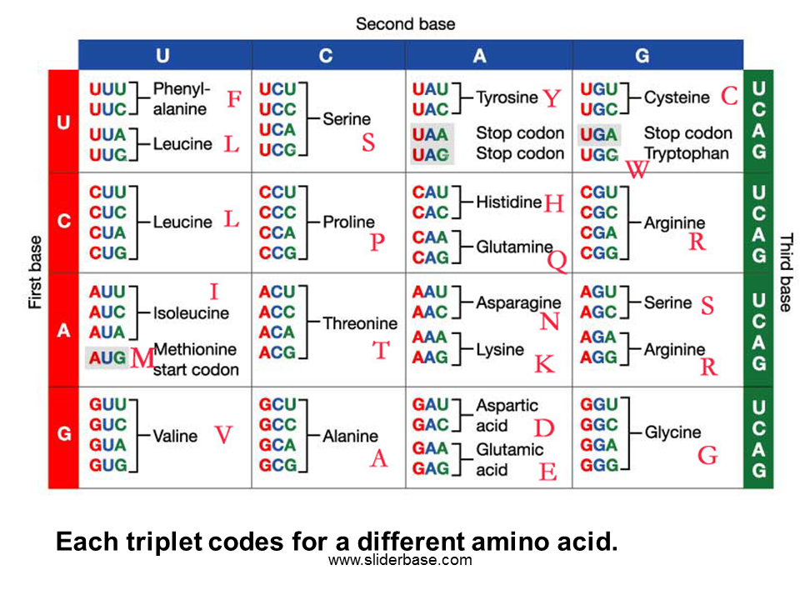
Central Dogma

Slide 15

Central Dogma
Why do the organisms need RNA and transcription step?

Slide 16
Central Dogma
Why do the organisms actually need DNA?

Slide 17
Central Dogma
Does the genetic code „length” correspond to organism complexity?

Slide 18
Central Dogma
If each cell in our body has „the same” DNA, why do we have different organs?

Slide 19
Central Dogma
Why 3 nucleotides correspond to one amino acid?

Slide 20
Central Dogma
Why there are only 4 nucleotides in DNA?

Slide 21
Central Dogma
What is the meaning and effect of codon redundancy?

Slide 22
Central Dogma
Why does RNA have U instead of T?

Slide 23
Central Dogma
Are the transcription and translation rules universal? Why?

Slide 24
Central Dogma
How does the cell regulate which gene is expressed?

Slide 25
Central Dogma
Why are proteins made of amino acids instead of nucleotides?

Slide 26
Central Dogma
Can the central dogma be inverted? Can the information flow „backwards”?

Slide 27

Sequences - Fasta
>SEQUENCE_1
MTEITAAMVKELRESTGAGMMDCKNALSETNGDFDKAVQLLREKGLGKAAKKADRLAAEG
LVSVKVSDDFTIAAMRPSYLSYEDLDMTFVENEYKALVAELEKENEERRRLKDPNKPEHK
IPQFASRKQLSDAILKEAEEKIKEELKAQGKPEKIWDNIIPGKMNSFIADNSQLDSKLTL
MGQFYVMDDKKTVEQVIAEKEKEFGGKIKIVEFICFEVGEGLEKKTEDFAAEVAAQL
>SEQUENCE_2
SATVSEINSETDFVAKNDQFIALTKDTTAHIQSNSLQSVEELHSSTINGVKFEEYLKSQI
ATIGENLVVRRFATLKAGANGVVNGYIHTNGRVGVVIAAACDSAEVASKSRDLLRQICMH
FASTA format:
One row with comment (identifier)
Second with the actual sequence

Slide 28


Sequences - Fasta
PROS
Easy to understand
Implemented in every tool
CONS
Flexible (DNA/RNA/Proteins)
Large size for big data
No metadata
Limitted comments
Only sequence

Slide 29

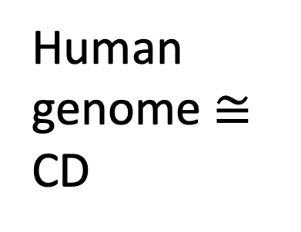
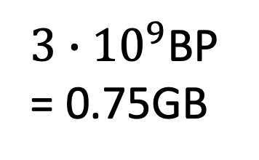
Sequences - Compression
1BP = 2bits (4 options) = 0.25B
Human genome $≅$ CD
$3∙{10}^{9}$BP = 0.75GB
BioBanks collect data on population scale

Slide 30
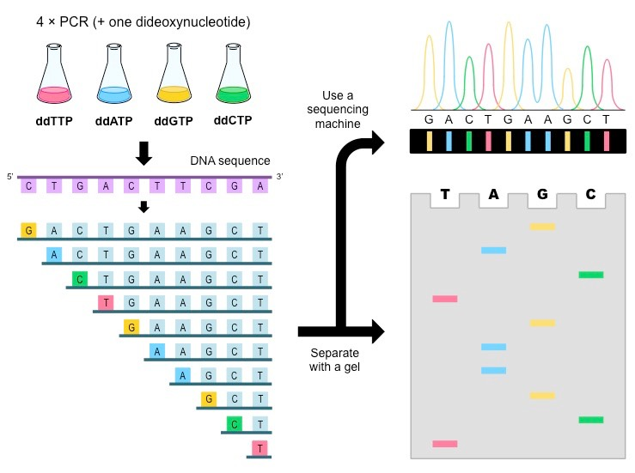
Sequences – Sanger Method

Slide 31
Sequences - Fastq
@SEQ_ID
GATTTGGGGTTCAAAGCAGTATCGATCAAATAGTAAATCCATTTGTTCAACTCACAGTTT
+
!''*((((***+))%%%++)(%%%%).1***-+*''))**55CCF>>>>>>CCCCCCC65
@SRR001666.1 071112_SLXA-EAS1_s_7:5:1:817:345 length=36
GGGTGATGGCCGCTGCCGATGGCGTCAAATCCCACC
+SRR001666.1 071112_SLXA-EAS1_s_7:5:1:817:345 length=36
IIIIIIIIIIIIIIIIIIIIIIIIIIIIII9IG9IC
1st, 3rd row – Identifier and separator
2nd row – Sequence
4th row - Quality

Slide 32
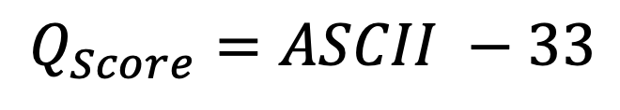
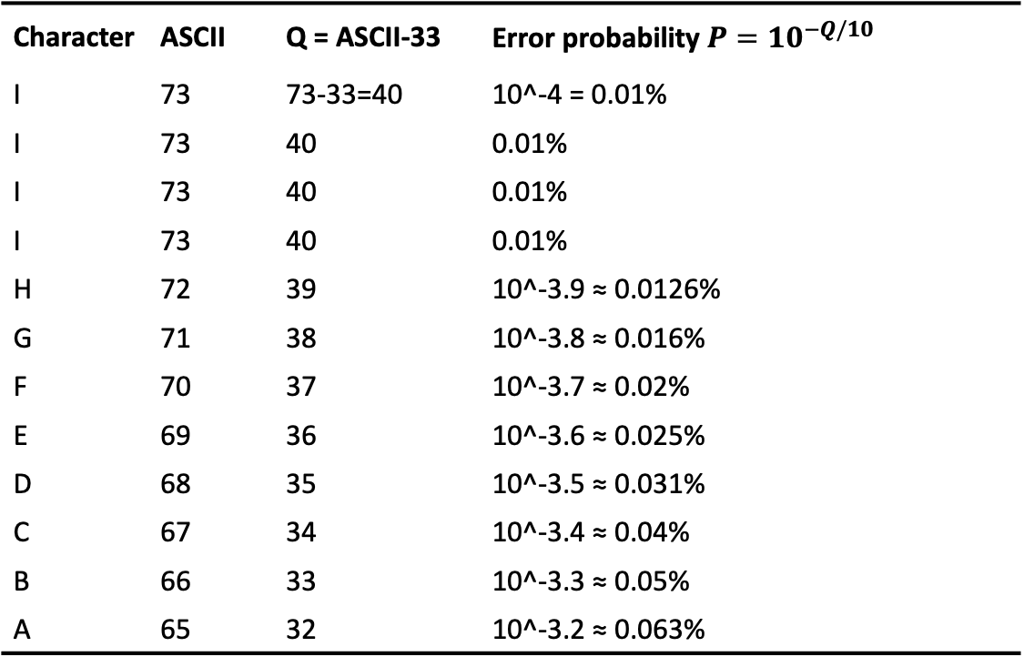
Sequences – Fastq quality
$$Q_{Score}=ASCII −33$$
Character | ASCII | Q = ASCII-33 | Error probability $P={10}^{−Q/10}$
I | 73 | 73-33=40 | 10^-4 = 0.01%
I | 73 | 40 | 0.01%
I | 73 | 40 | 0.01%
I | 73 | 40 | 0.01%
H | 72 | 39 | 10^-3.9 ≈ 0.0126%
G | 71 | 38 | 10^-3.8 ≈ 0.016%
F | 70 | 37 | 10^-3.7 ≈ 0.02%
E | 69 | 36 | 10^-3.6 ≈ 0.025%
D | 68 | 35 | 10^-3.5 ≈ 0.031%
C | 67 | 34 | 10^-3.4 ≈ 0.04%
B | 66 | 33 | 10^-3.3 ≈ 0.05%
A | 65 | 32 | 10^-3.2 ≈ 0.063%
@SEQ_ID
GATCTAGCTAGC
+
IIIIHGFEDCBA

Slide 33
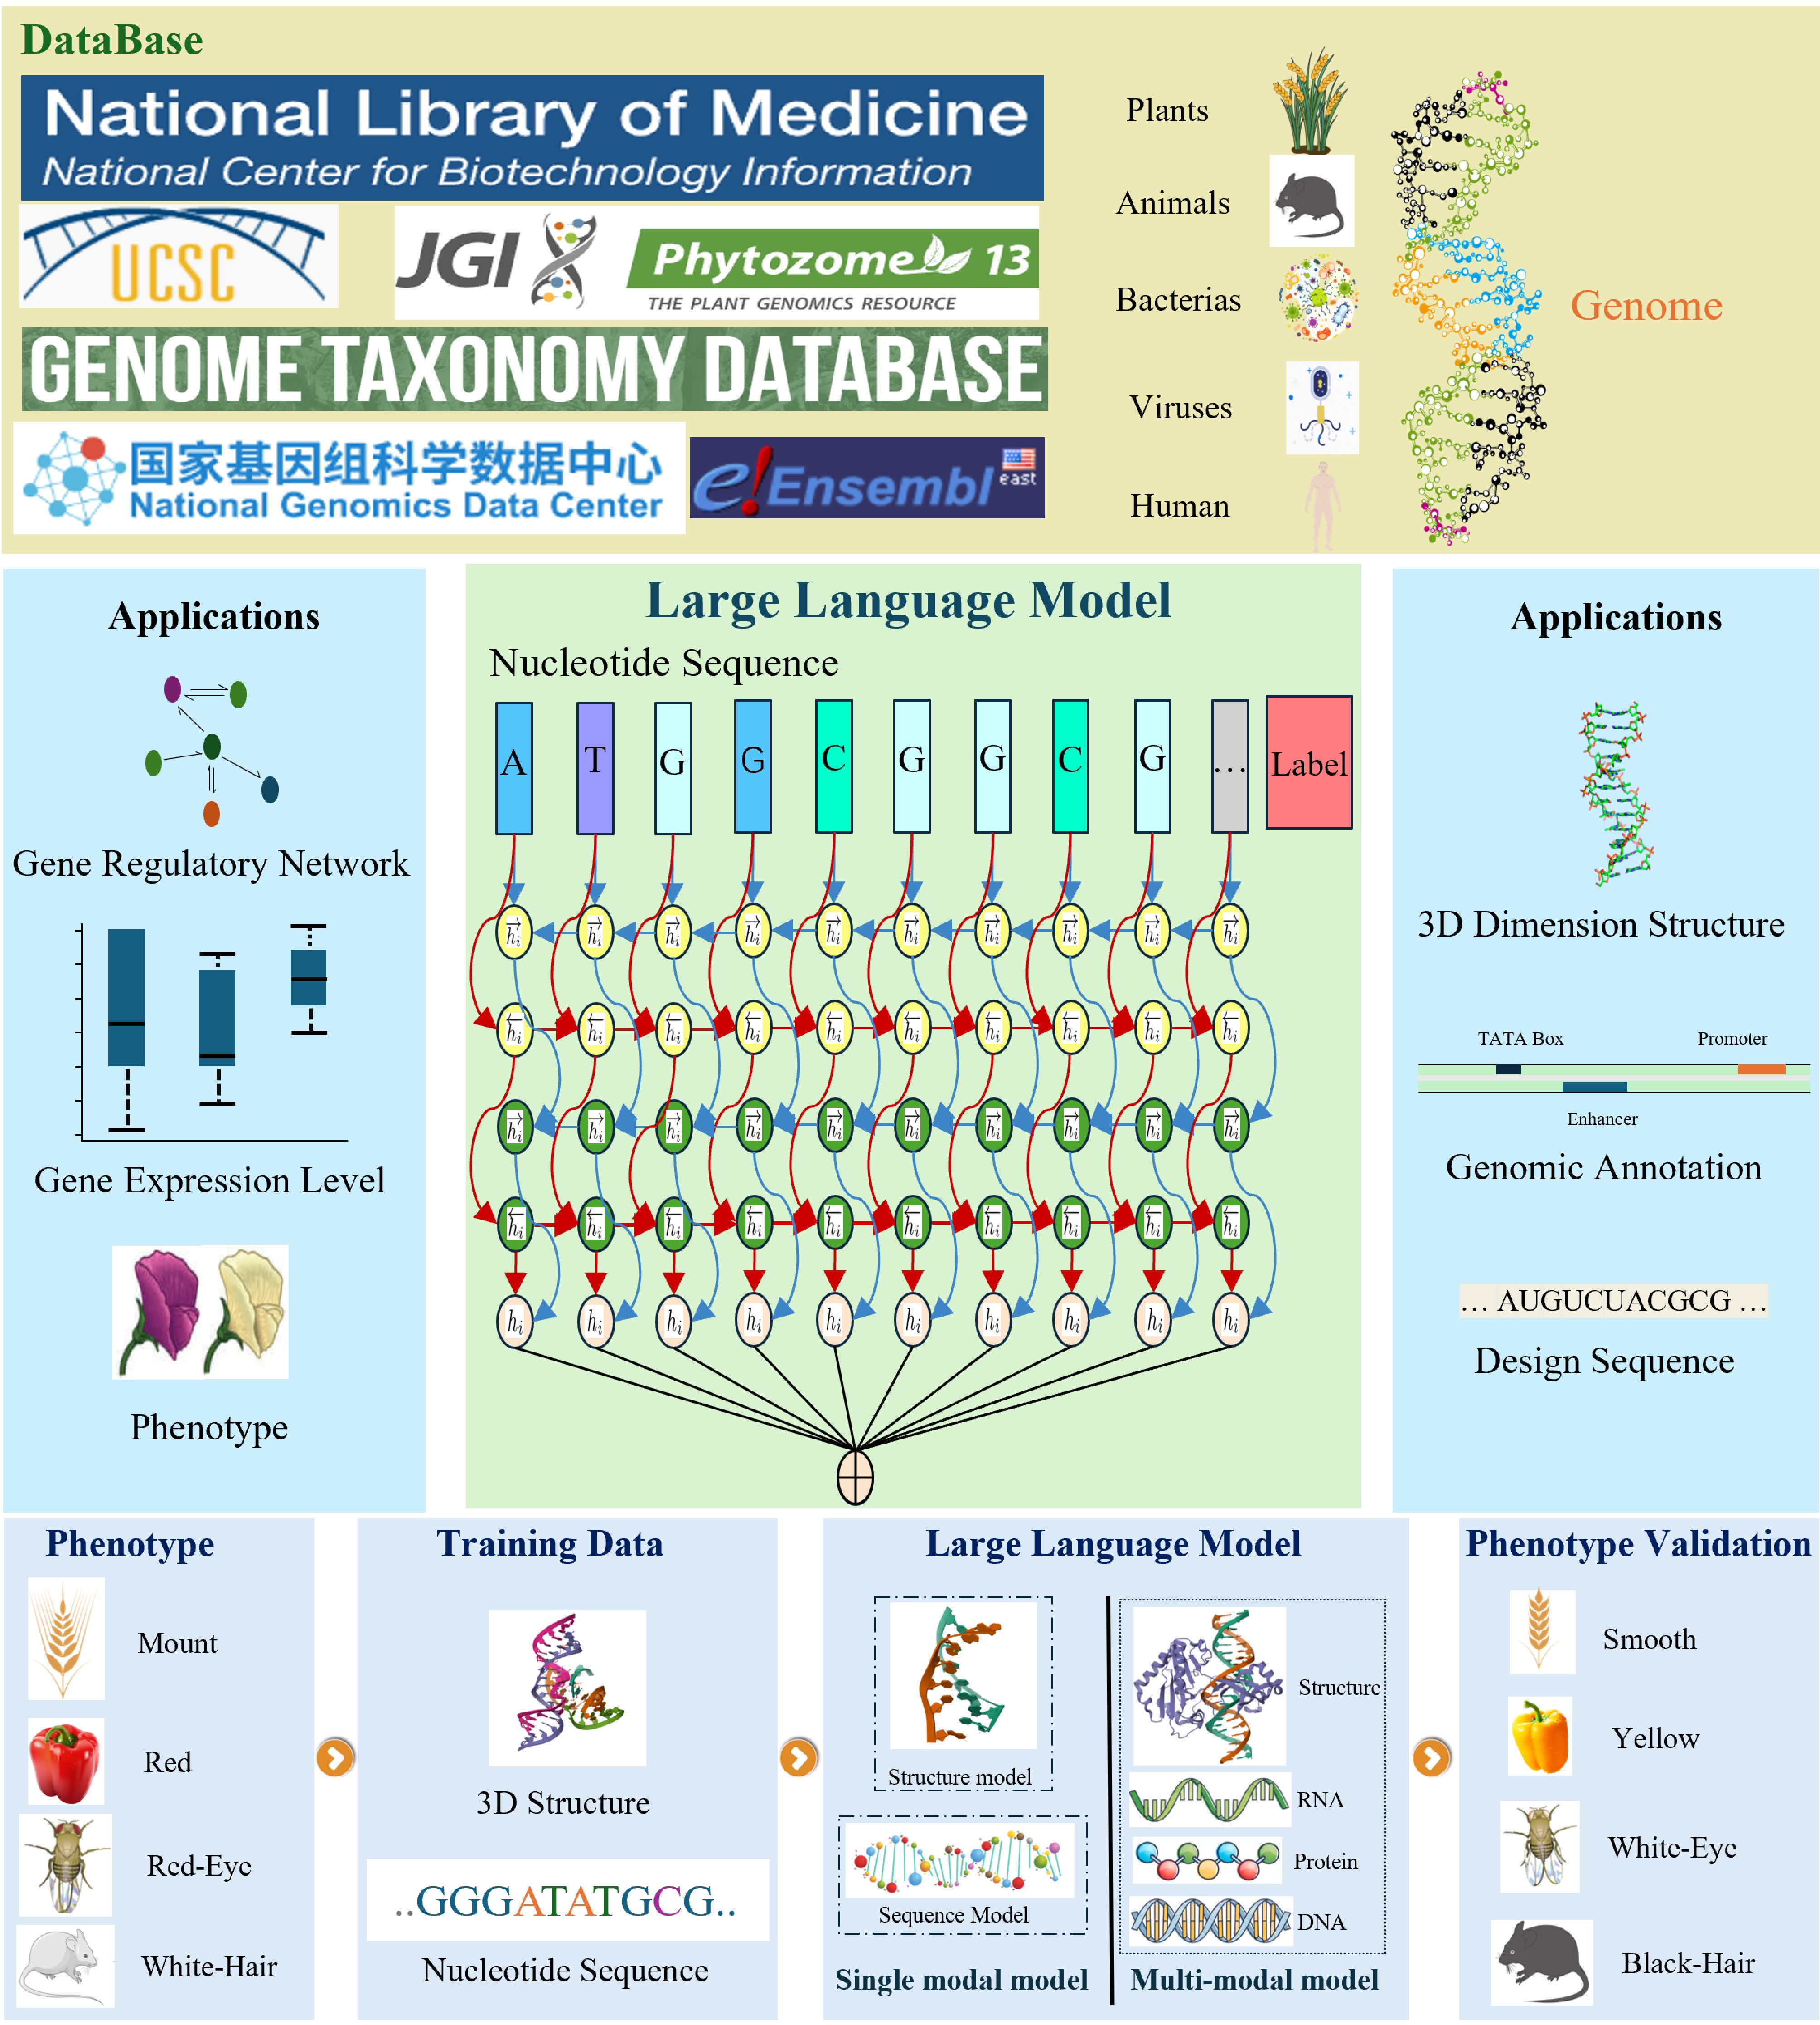
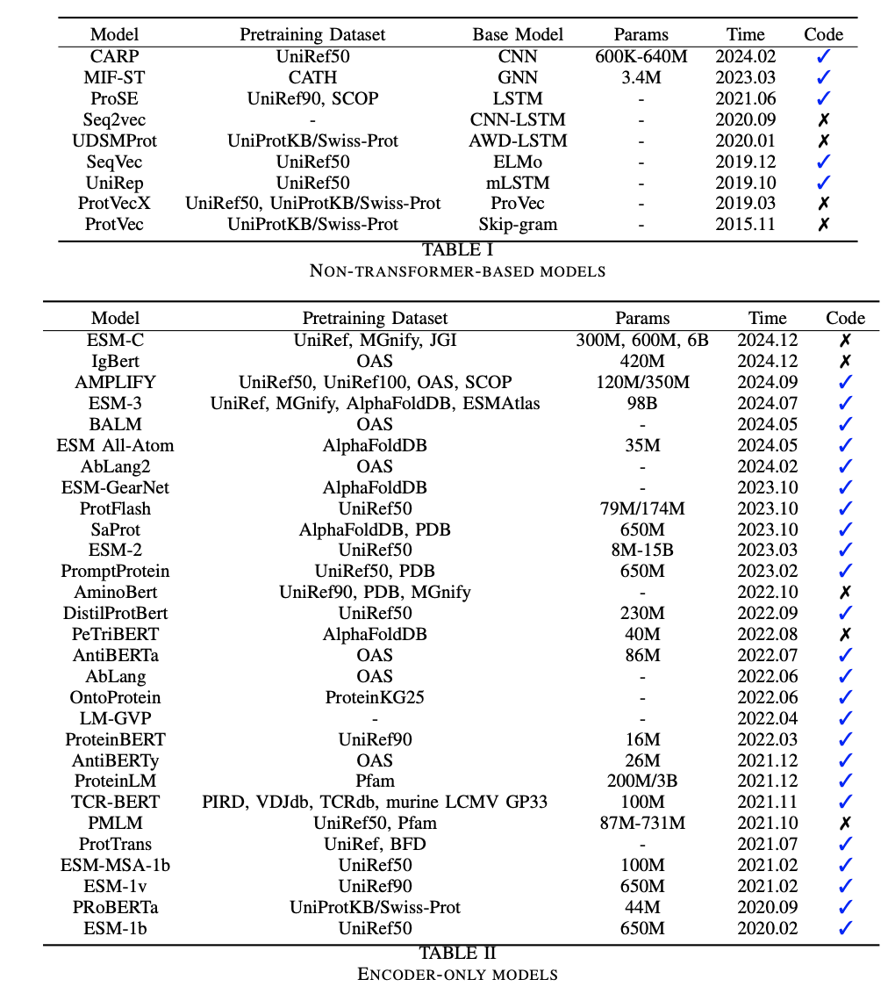
Sequences – Deep Learning approach
Nucleic Acids LM
Protein LM

Slide 34


Coding demonstration

Slide 35
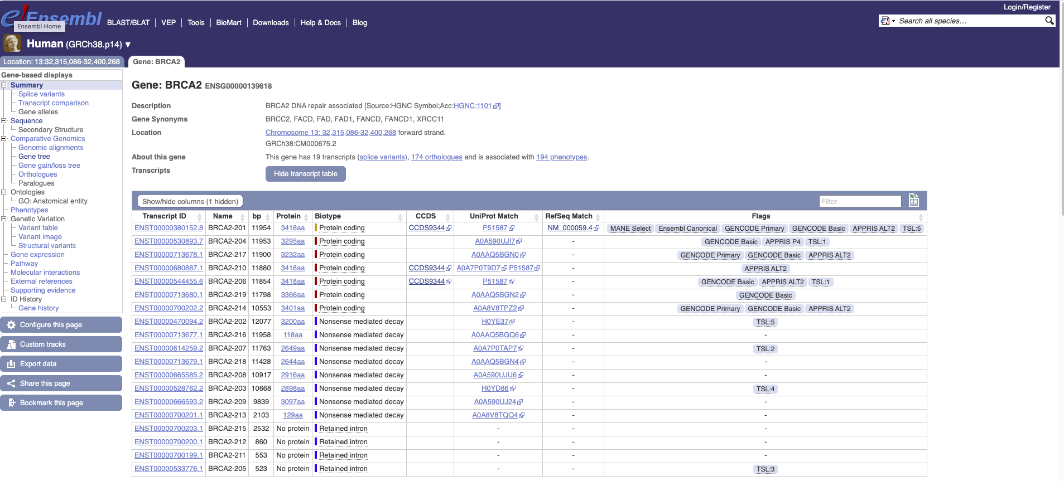
Databases - Ensembl

Slide 36
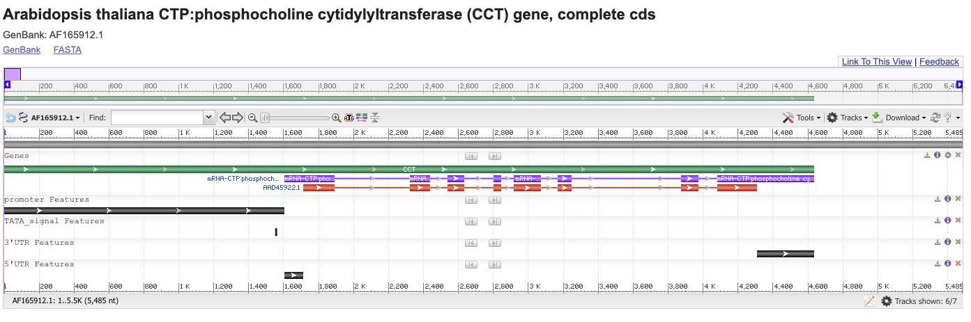
Databases - GenBank

Slide 37
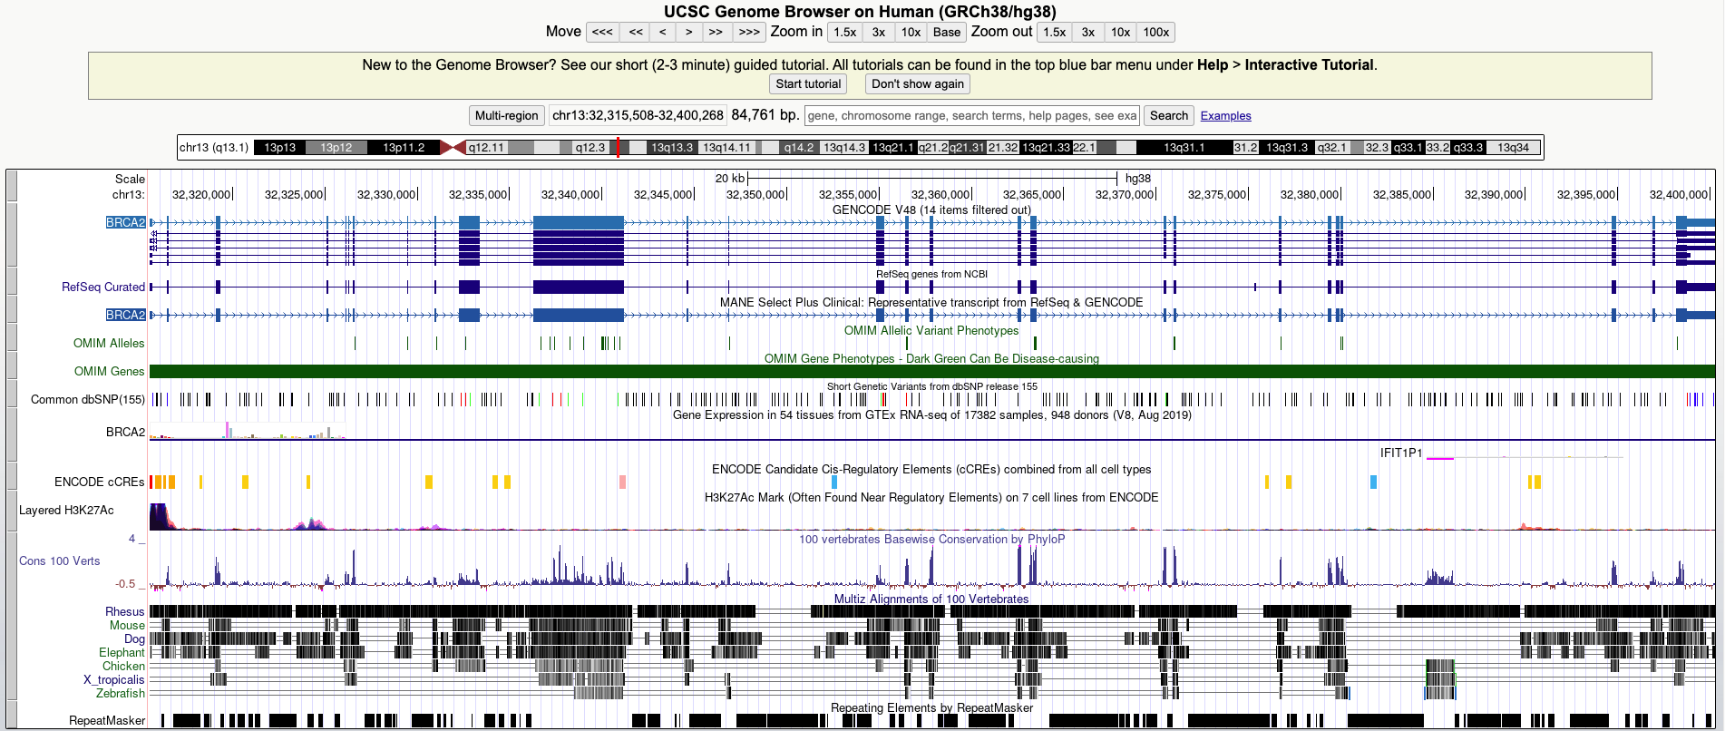
Databases – UCSC Genome Browser

Slide 38
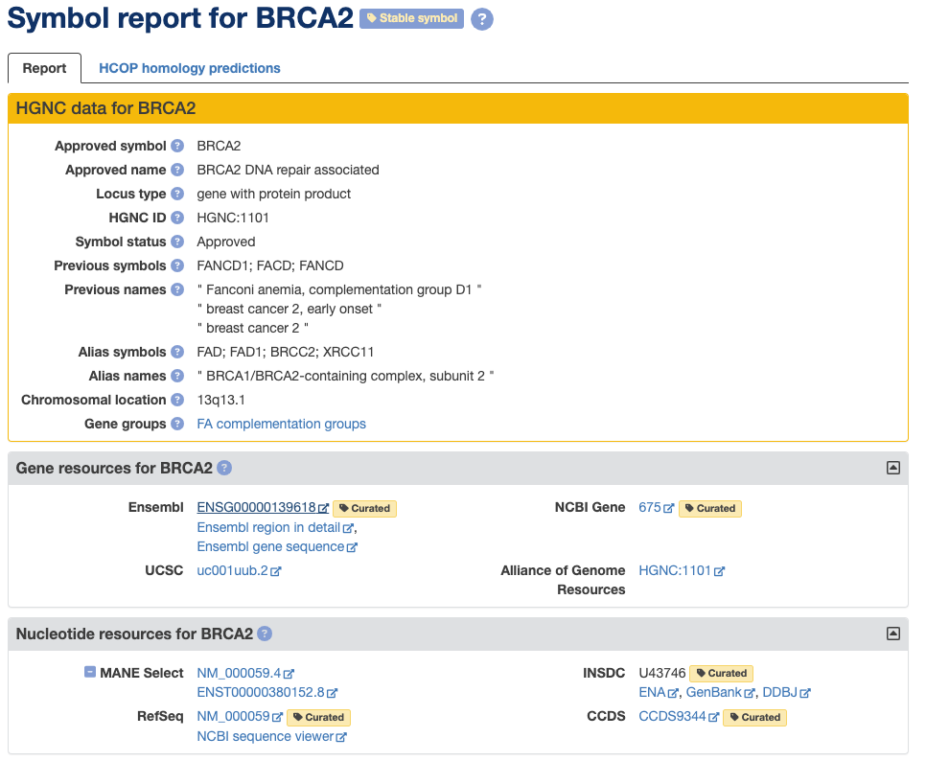
Databases - HGNC

Slide 39
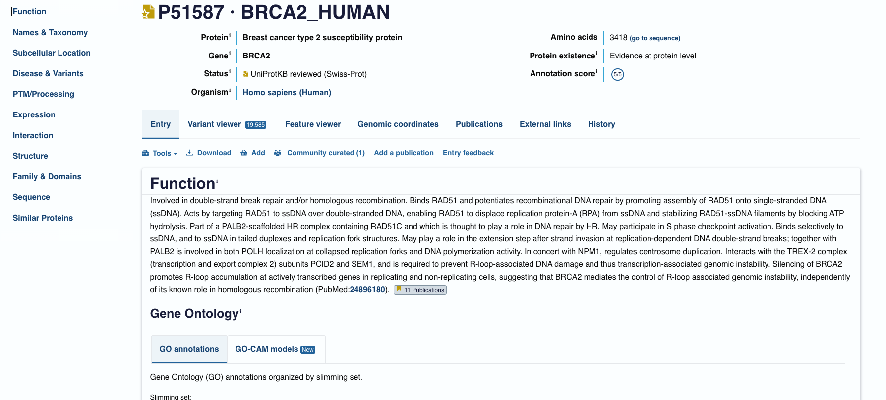
Databases - UniProt

Slide 40





Wrap-UP
The core role of sequential data in bioinformatics
Central dogma and its consequences
Simple code for manipulating sequences
A few databases with genes and protein sequences

